Slide 1
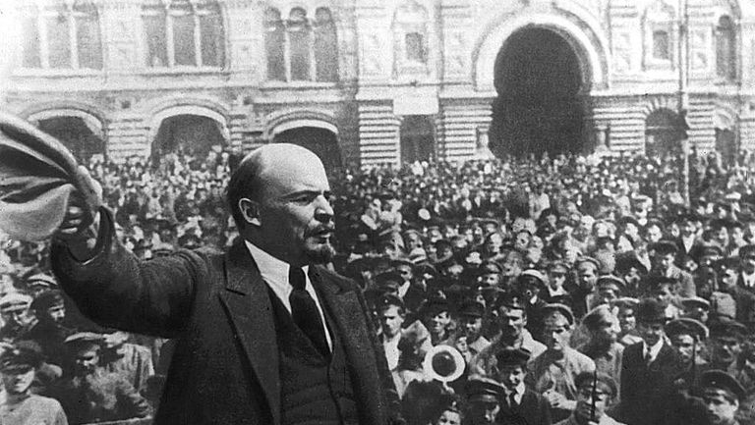
Russian Revolution

Slide 2
Part One: Tsarist Russia in the World System

Slide 3
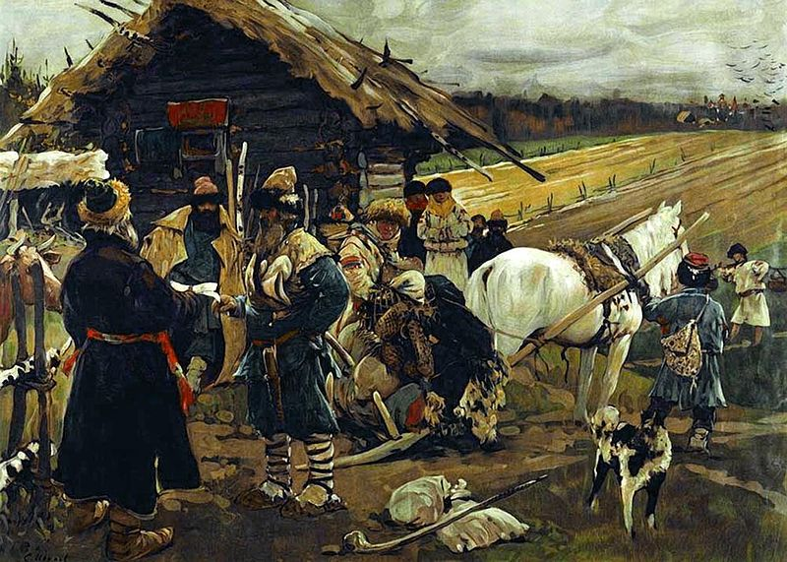
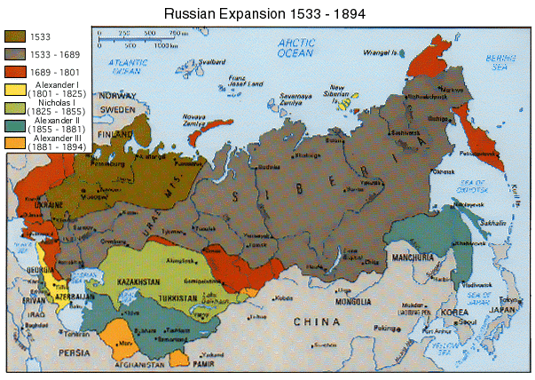
Russian Backwardness
Peter the Great and Catherine I expanded in Ottoman Empire and Eastern European territory in the eighteenth century
Serfdom basis of the economy well into the eighteenth century
Tremendous expenditures for expansion were not matched by revenues, borrowed on European markets to make up the difference
By World War One remained an absolutist monarchy

Slide 4
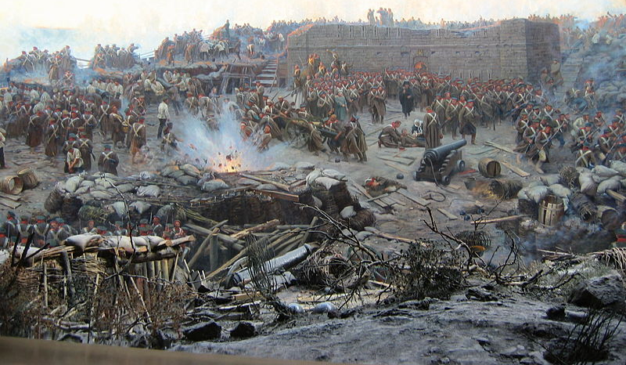
Russian Capitalist Development
Defeat in Crimean War (1853-6) spurred state-led capitalist development
More directly tied to military than in Europe

Slide 5
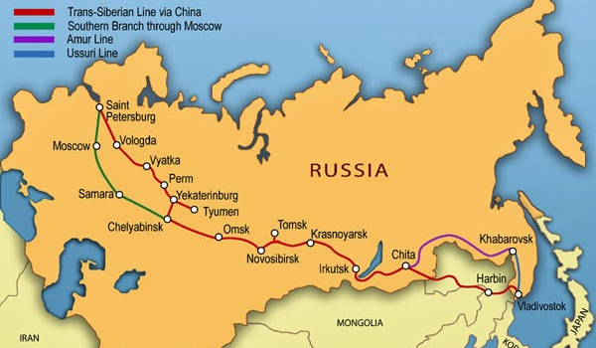
Russian State Capitalism
11 out of 19 thousand miles of rail built between 1851 and 1894 were directly owned by the state
Customs completely barred entry of English manufactures
State development agenda with low taxable revenue opened possibilities for foreign finance capital
Total production rose from 1.5 billion roubles in 1890 to between 2.5 and 3 billion in 1900
Factory workers increased from 1.4 to 2.4 million, mostly former serfs

Slide 6
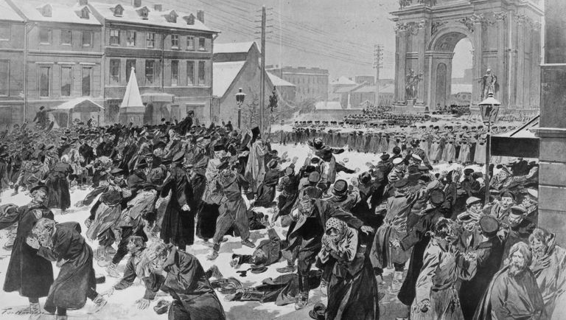
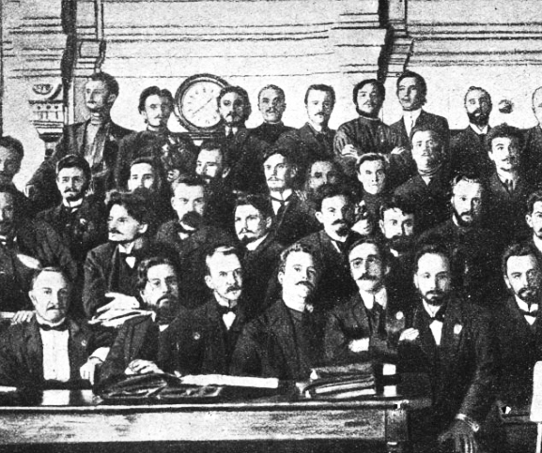
1905
Strikes increased each year from 1901-1905
“Bloody Sunday” January 22, 1905
Soviet (workers’ council) formed in St. Petersburg

Slide 7
Part Two: Bolshevik Theory and the Marxist Tradition

Slide 8

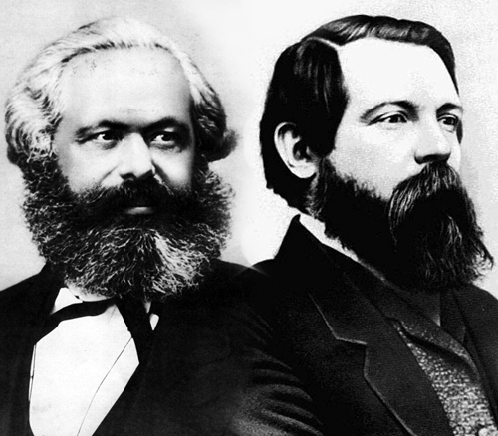
Marxism and the Enlightenment
Wrote Communist Manifesto in context of Revolutions of 1848
Sketched a “stage theory” of history, evolution of social forms: primitive communism, slave society, feudalism, capitalism, socialism, communism
Lesson of 1848- the European bourgeoisie was more afraid of radical revolution than aristocratic conservatism

Slide 9
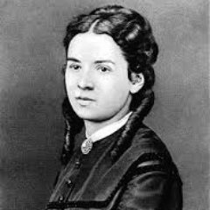
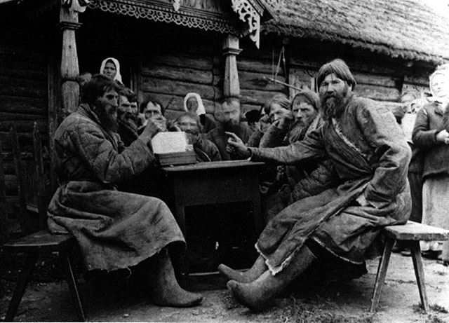
Marxism and Narodniki (Russian Populism)
Freed serfs continued to peasant communal tradition, collective ownership and farming of the land
Narodniks argued Obshchina/Mir bypassed capitalist development in Russia, skipping directly to socialism
In letter to Vera Zasulich, Marx kind of agreed

Slide 10
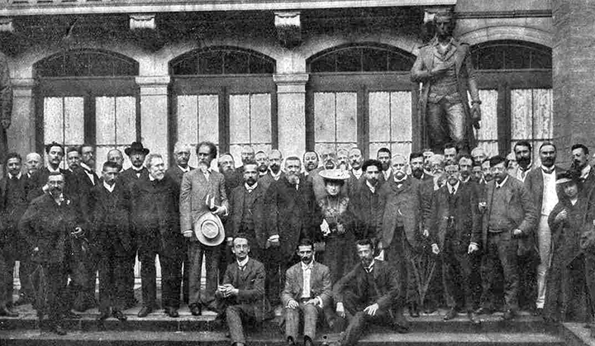
The Second International
International organization unifying various national sections of international socialism
Strongest section was German SPD, led by Karl Kautsky
Historically remembered for promulgating “orthodox Marxism,” reality is more complicated
Tried to work out “universal” program encompassing all sections

Slide 11
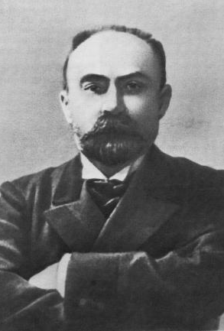
RSDLP
Russian section of the Second International
All agreed Russian working class would have to lead “bourgeois-democratic revolution”
Split into Bolshevik/Menshevik factions in 1903 over issues of organization and alliances with other classes

Slide 12
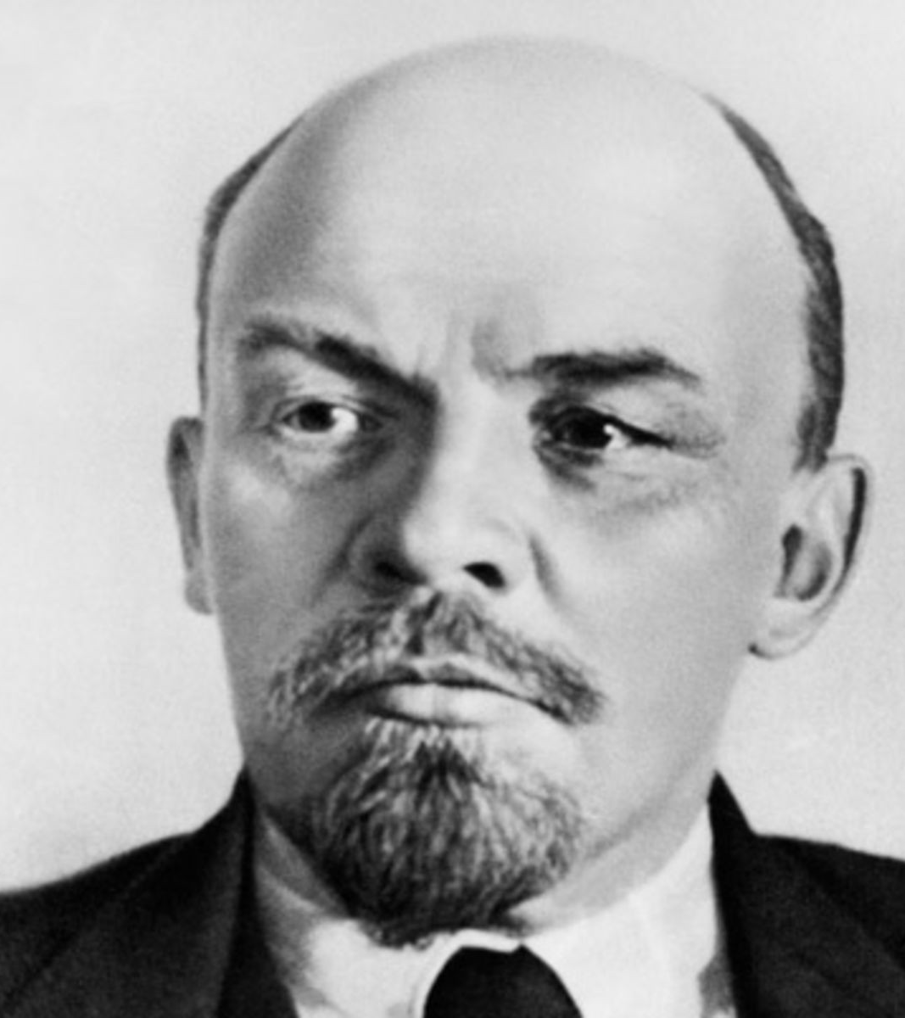
Lenin
Workers should ally with peasants to press for “bourgeois-democratic” revolution
Transition to socialist phase would unfold on world terrain
Tsarist repression required disciplined cadre of professional revolutionaries
The state was the instrument of the ruling class (a dictatorship of the bourgeoisie)

Slide 13
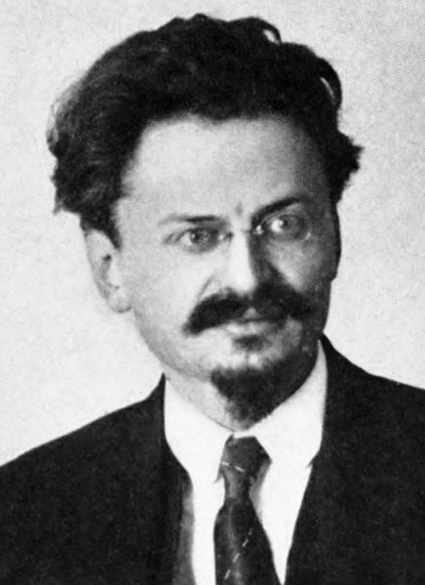
Trotsky
Allied with the Menshevik faction until 1917
Opposed Lenin’s disciplined party of professional revolutionaries
Argued working class leadership of revolution would necessarily put the aims of socialism on the agenda
Believed Russia would skip bourgeois-democratic phase, but would become isolated without the aid of European socialist revolutions

Slide 14
Part Three: Revolution in Three Acts

Slide 15
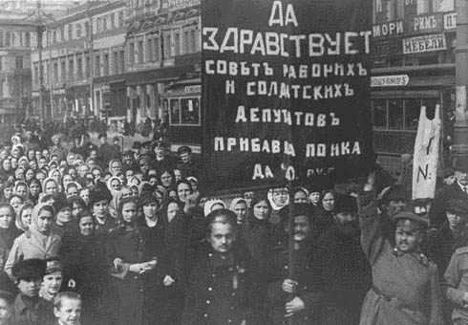
Act One: Spontaneous Mass Movement

Slide 16
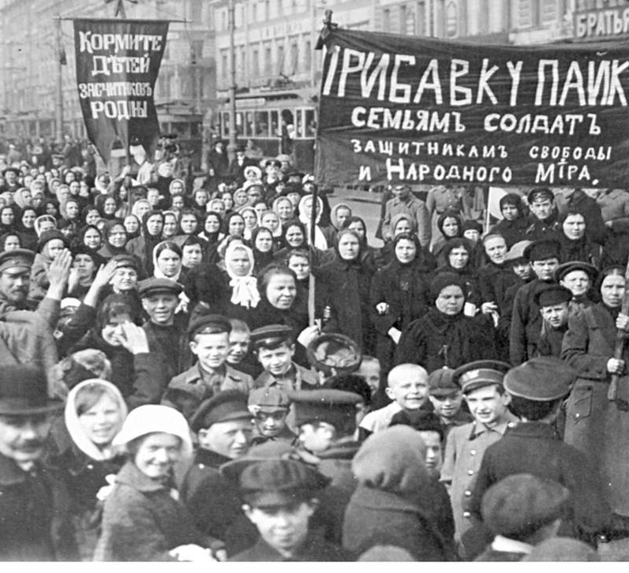
Bread Riots

Slide 17
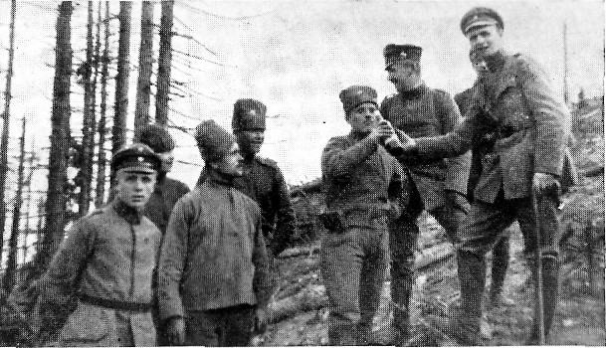
Soldiers for Peace

Slide 18
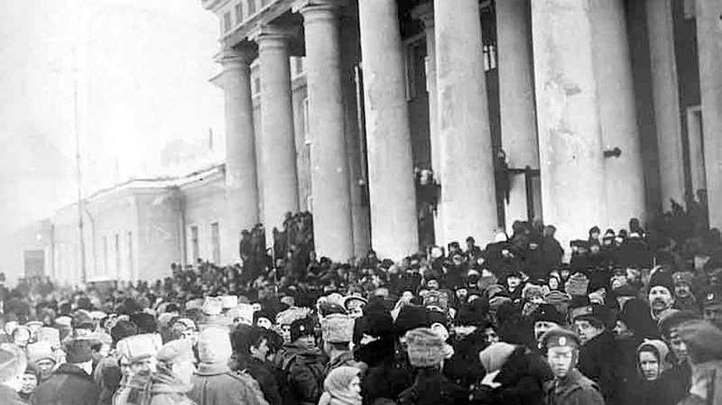
Storming Tauride Palace

Slide 19
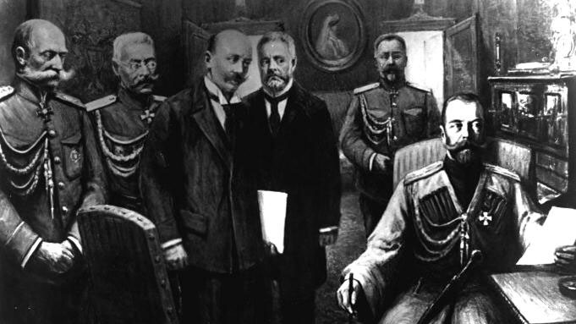
Tsar Abdicates the Throne

Slide 20
Act Two: Dual Power

Slide 21
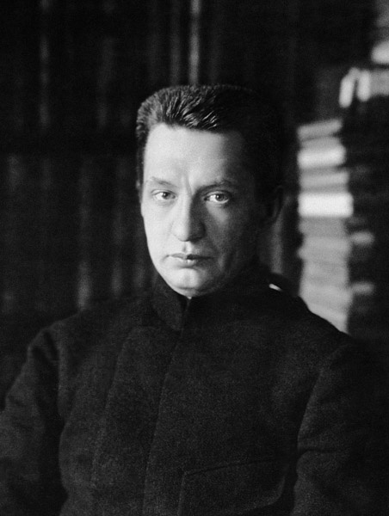
Provisional Government

Slide 22
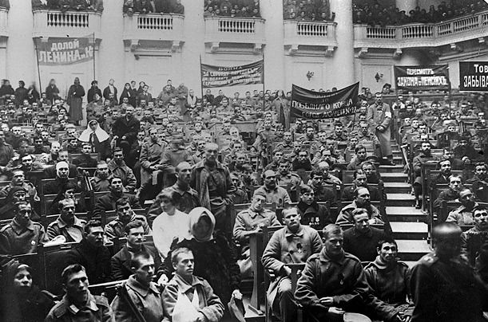
Petrograd Soviet

Slide 23
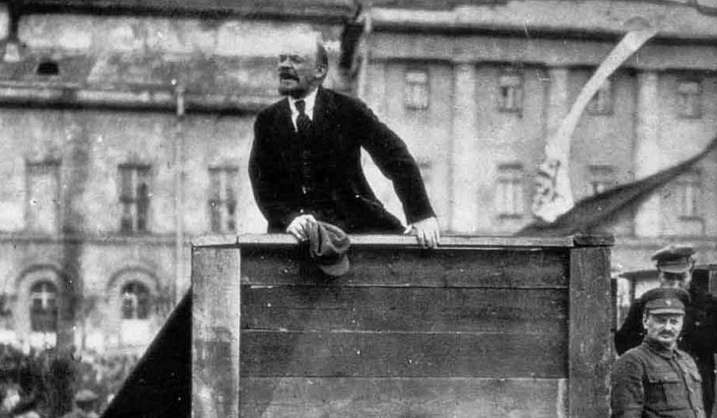
Lenin’s April Theses

Slide 24
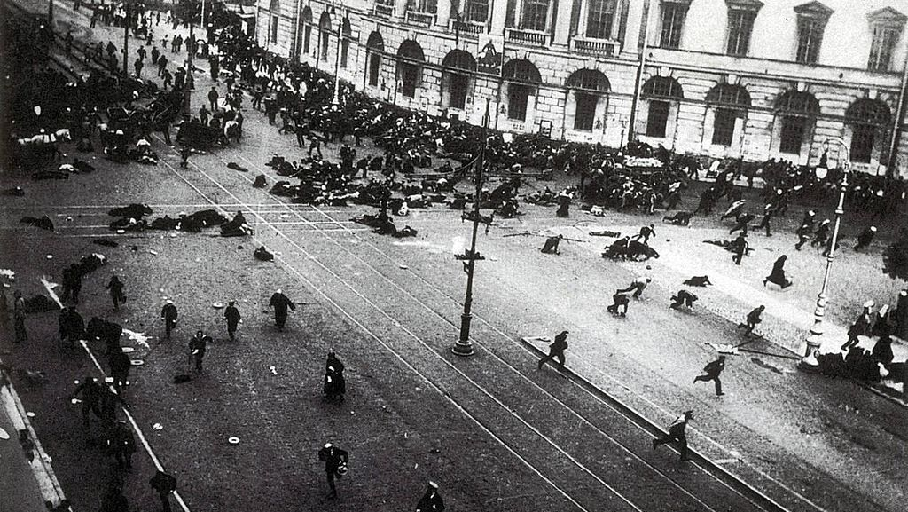
July Days

Slide 25
Act Three: Power to the Soviets

Slide 26
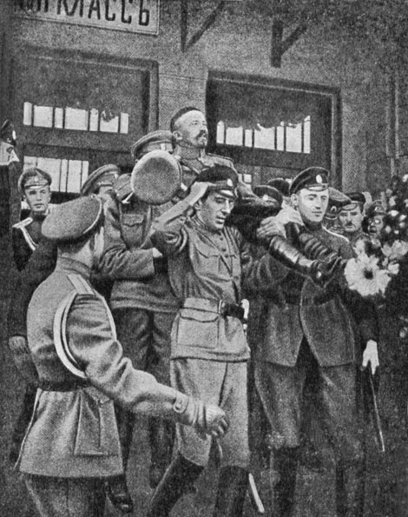
The Counter-Revolution Rears its Head

Slide 27
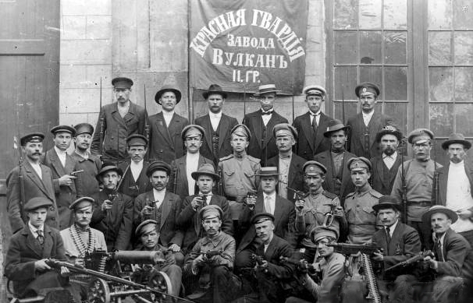
Soviets Repel the Attack

Slide 28
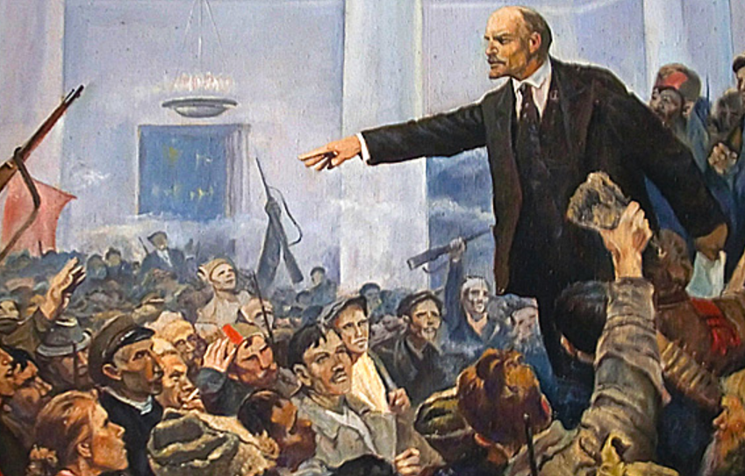
Bolsheviks Win the Soviets

Slide 29
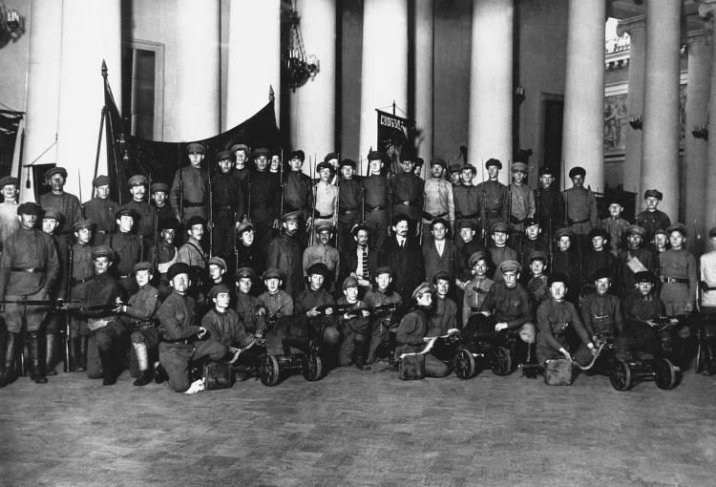
End of Dual Power: All Power to the Soviets

Slide 30
Epilogue
Revolution followed by Civil War
Until 1923 Bolsheviks believed they had fired the opening shot in a world socialist revolution
Left movements worldwide had a new symbol of hope

